Slide 1
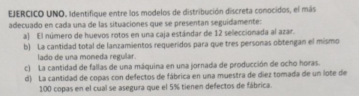

Slide 2
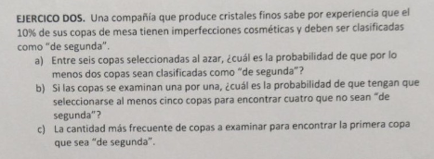

Slide 3



Slide 4





Slide 5




Slide 6


Slide 7



Slide 8
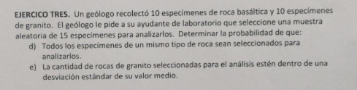




Slide 9







Slide 10









Slide 11




Slide 12
















Slide 13

















Slide 14











ppois(4,9,lower.tail = F)

Slide 15






Slide 16



























Slide 17






